Slide 1
Credit Card Fraud Detection
Team 1-10
Tanner Reichard, Yuwei Yao, Jiaxin Lu, Yuchen Zhao
Notes:
Hi Everyone! We are group 10. Today we are talking about Credit Card Fraud, which is a relatively common phenomenon that could cause huge financial loss to you if a credit card fraud happen.

Slide 2

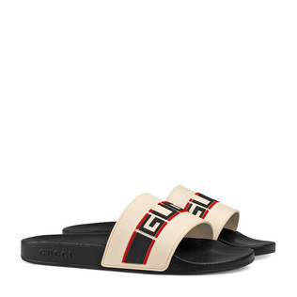
Agenda
Introduction
Introduction to Fraud
Introduction to Dataset
Data Exploration
Data Processing
Exploratory Data Analysis
Modeling
Decision Tree
Random Forest
Resampling
K-Means Clustering
Conclusion
Notes:
Picture this: you’re surviving on your grad school budget of pizzas and you suddenly get a charge from Gucci for a pair of $400 flip flops. What happened here? Either you have bad taste, or you’re likely a victim of credit card fraud!
Predicting credit card fraud can save banks and their customers immense amounts of value and goodwill, making it a good topic of pattern analysis for machine learning.
Today, our analysis into credit card fraud will follow a quick introduction, dataset exploration, modeling, and our ultimate conclusions.

Slide 3
Introduction

Slide 4

Introduction to Fraud
· What is Credit Card Fraud
Theft and Fraud committed using or involving a payment card
Uncommon, concealed, changing over time, organized
· Our project
Analyzing European credit card transaction data
Using different machine learning models to detect fraud
Notes:
The unauthorized use of an individual’s credit card or card information to make purchases, or to remove funds from the cardholder’s account.
This is when other people use your cc to make purchase or remove refunds without informing you.This brings to our project:
After we analyzing this credit card transaction data, we use different machine learning models including DT, RF to detect fraud, find some variables that important.
As bank analysts, we can detect some accounts with abnormal transaction in these fields, further to detect fraud.

Slide 5
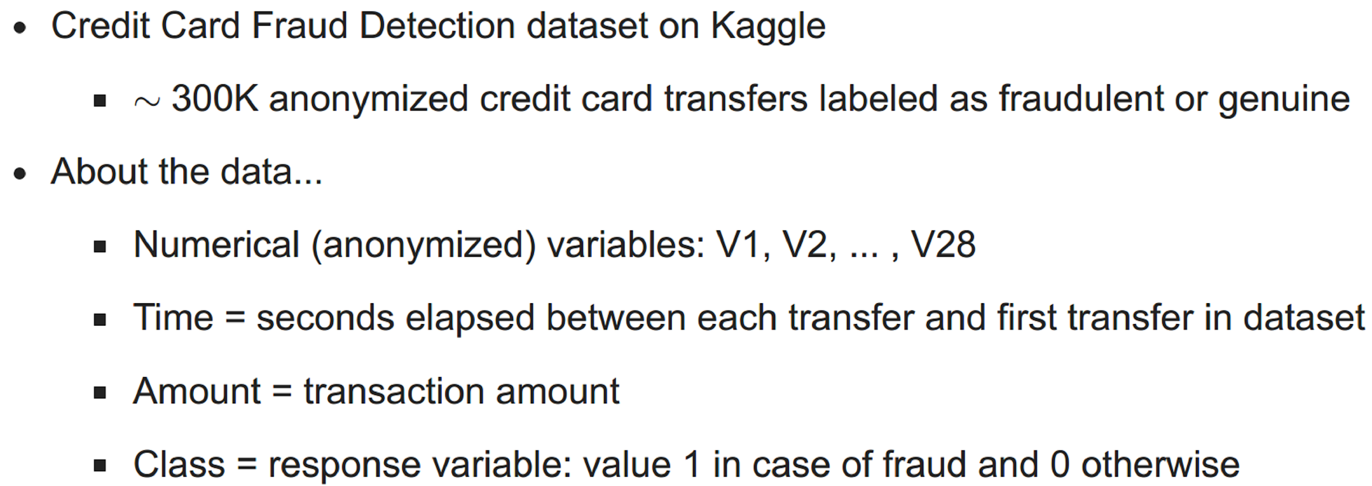
Introduction to Fraud
· Our Business Problem:
- To help companies detect which patterns signal fraudulent activity
Notes:
Dataset Introduction:
This datasets contains transactions made by credit cards by european cardholders in 2013., Let’s take a look at all these variables.
Class is a binary variable. 1 means that’s a fraud transaction and 0 means not a fraud transaction.
Time is the number of seconds elapsed between this transaction and the first transaction listed in this dataset.
Amount means transaction amount, which means the $ you lost on this fraud.
Features V1, V2, ... V28 are the principal components obtained with PCA, due to confidentiality issues,

Slide 6
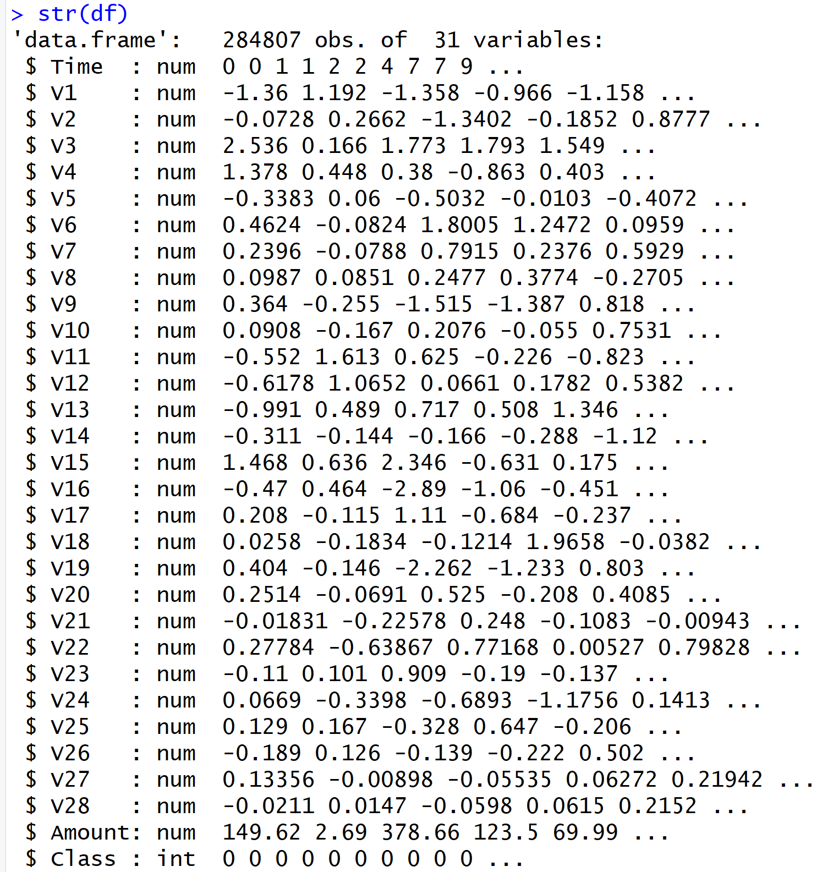
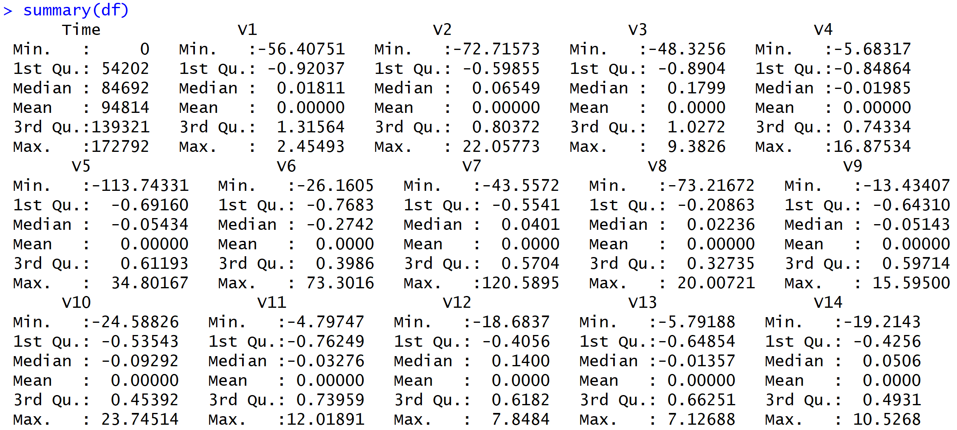
Data Overview
Notes:
Once we put the dataset in R, we can have a general idea about data looks like.
There are 300K records in this credit card fraud dataset.

Slide 7
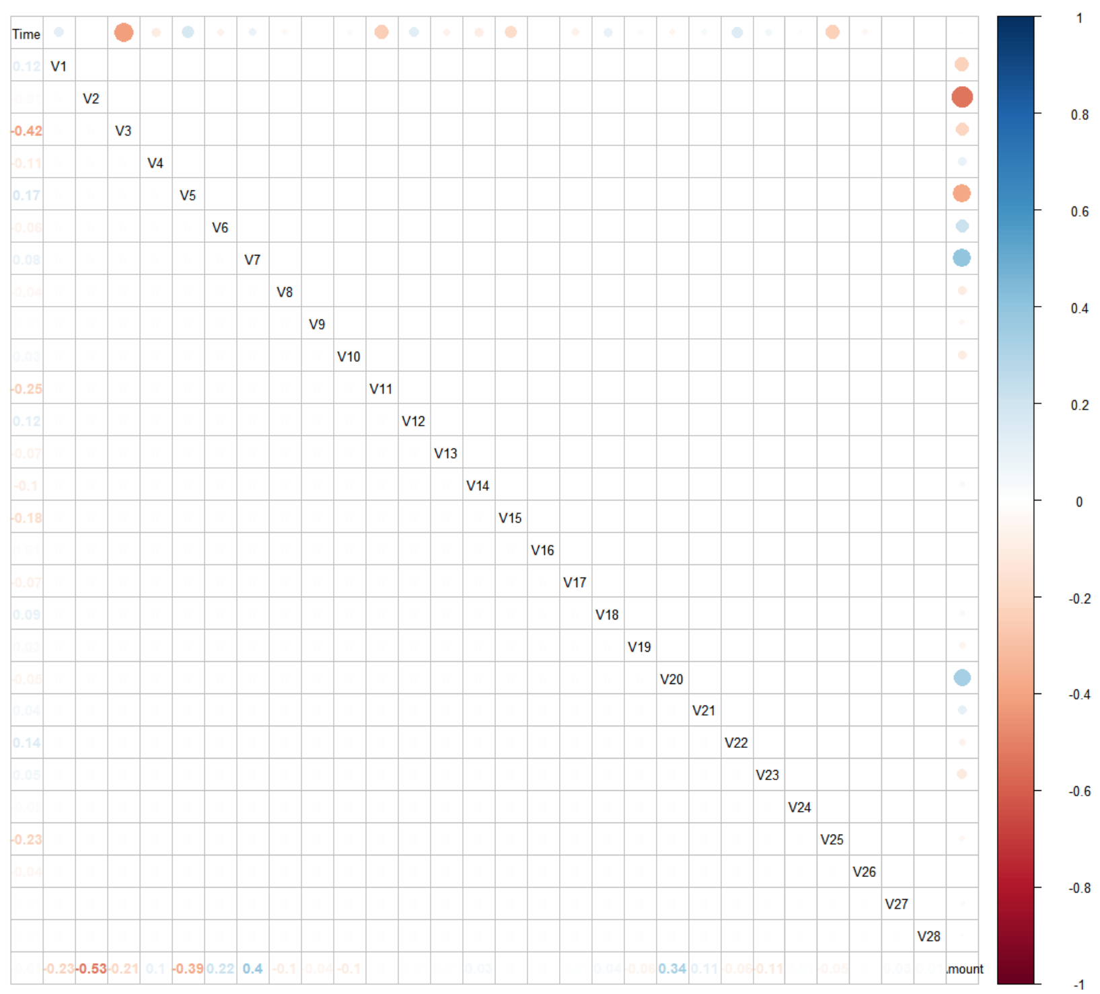
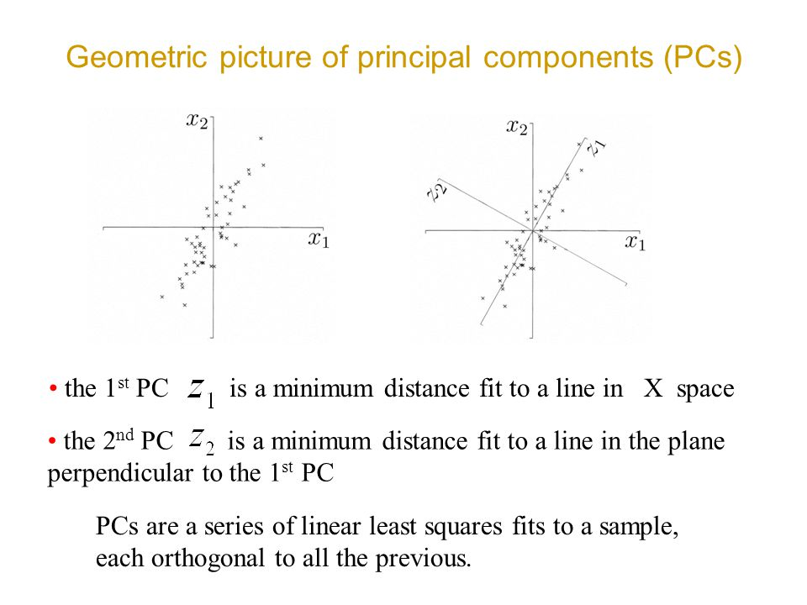
Recall Principal Component Analysis
Notes:
Tanner
In a preliminary look at our data, we noticed some interesting trends in our variables--namely their similarity to the structure of principal components.
As we recall from our studies into principal component analysis, we know that as the principal components are fit to a sample as a series of linear least squares, they become orthogonal to the previous component. This means that each variable in our dataset should be uncorrelated.
From our correlation matrix, we find that no variables are correlated, signaling that these are most likely principal components.

Slide 8
Data Exploration
Notes:
Miranda

Slide 9
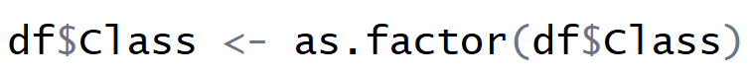
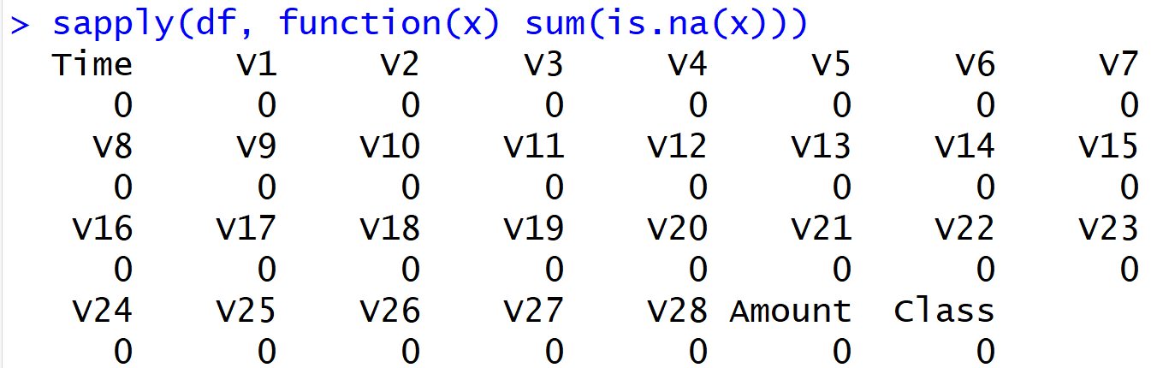
Data Processing
Data Transformation:
Missing Value Check:
Notes:
Miranda
Since this is a classification problem, the class variables are integer which needs to transfer from integers to factors
While checking our dataset for missing values, we found 0 null entries.

Slide 10
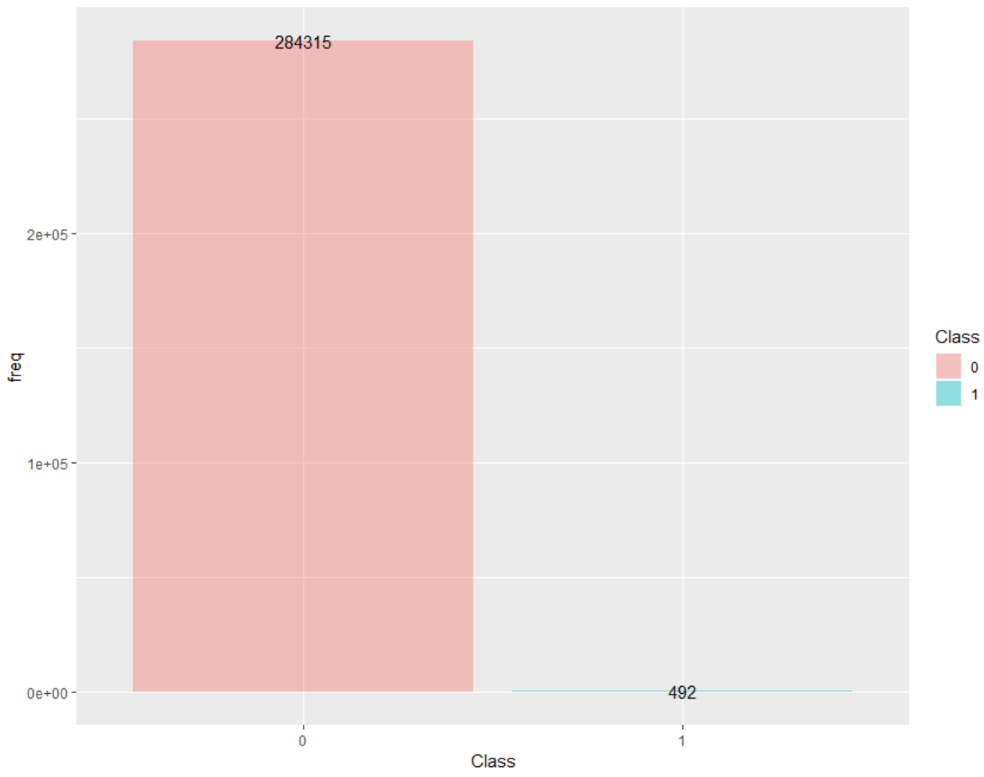
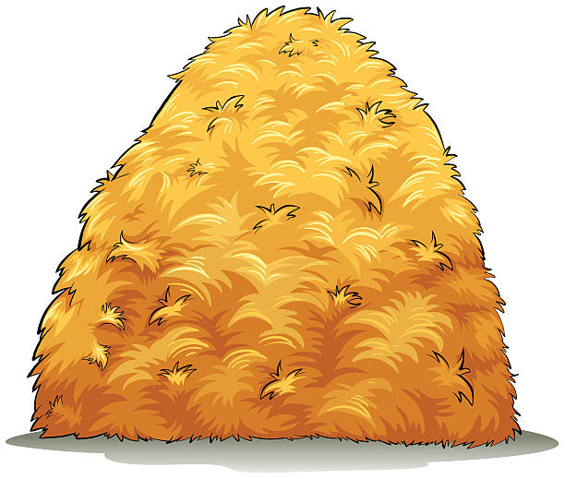
Exploratory Data Analysis
Distribution Fraud and non-Fraud
0.998
0.002
Notes:
What we found in our analysis of the dataset is that it’s extremely unbalanced--that is to say, there are very few cases of fraud in comparison to many cases of normal, non-fraudulent activity.
In fact, the ratio of non-fraud to fraud cases is 99.8% to 0.2%.
This ultimately means we’re looking for some very small needles in a very, very large haystack.
[realife - imbalance data!]

Slide 11
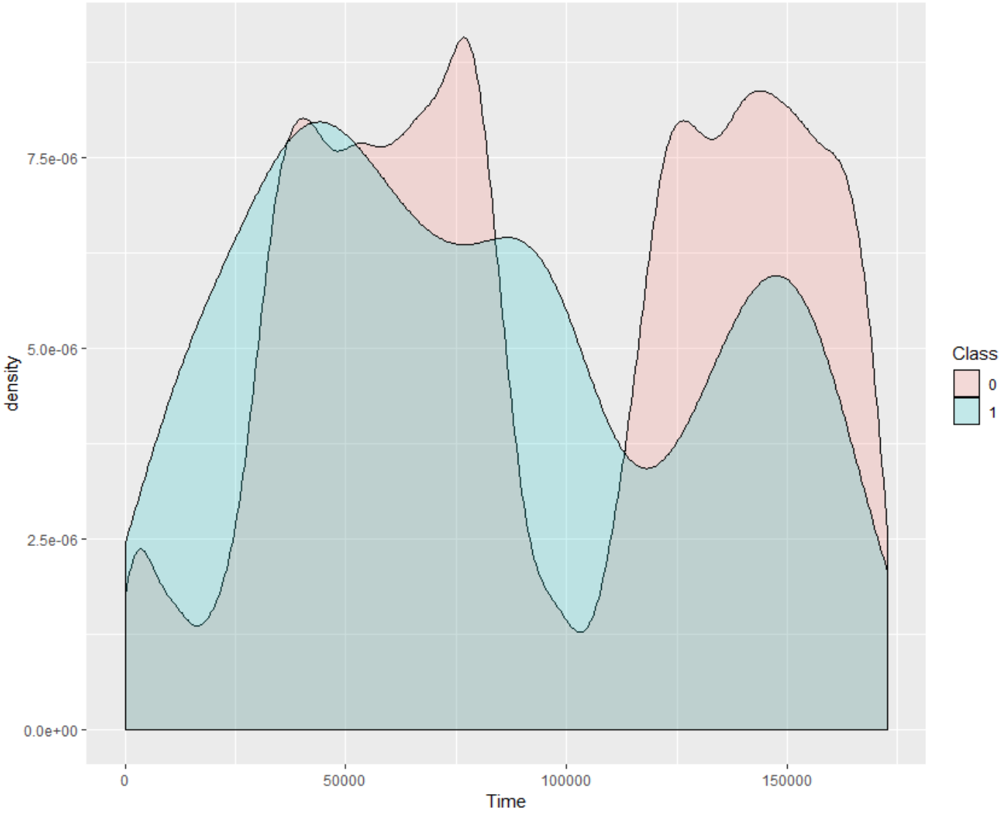
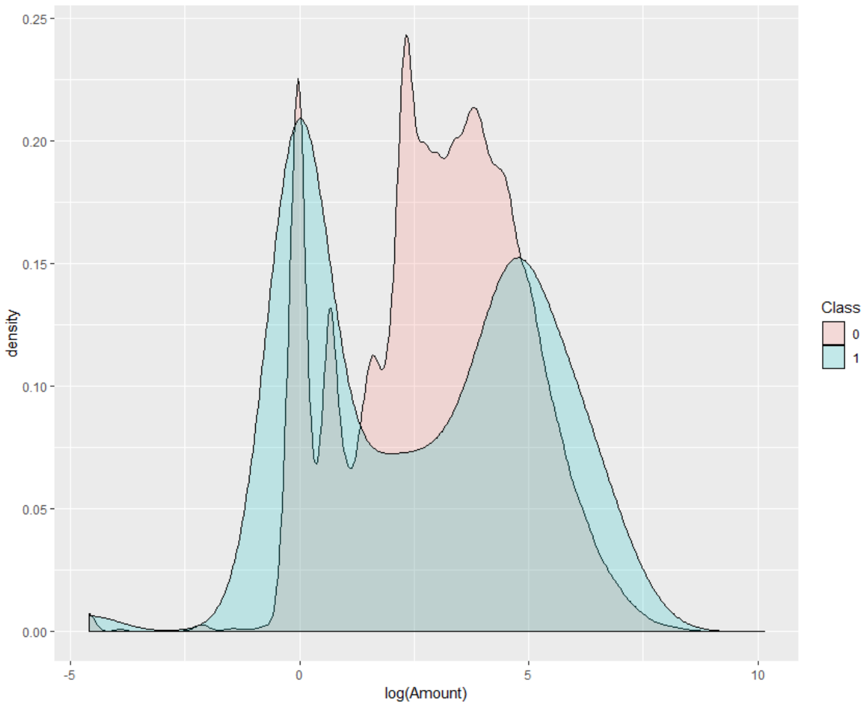
Exploratory Data Analysis
Distribution of Time on Fraud and non-Fraud
Distribution of Amount on Fraud and non-Fraud
Notes:
Tanner
Further in the variables time and amount, we thought we would find some large differences between consumer behavior (marked in pink) and fraudulent behavior (marked in turqoise) largely follow the same patterns.
This signals that we’ve got some very crafty identity thieves out there folks, which makes our job a bit tougher.
Turn it over to Yuwei

Slide 12
Modeling

Slide 13
Fraud Detection with Labelled Data
Decision Tree
Changing prior probability
Applying loss matrix to tree split
Applying loss matrix to cutoff tuning
Random Forest
Changing prior probability
Applying loss matrix to tree split
Changing sample size
Applying loss matrix to cutoff tuning
Notes:
Put process picture here

Slide 14
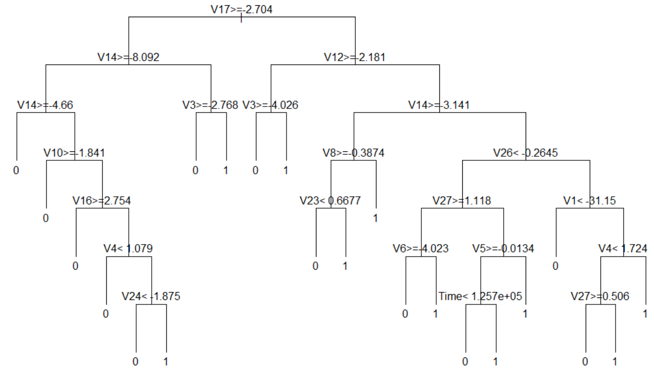
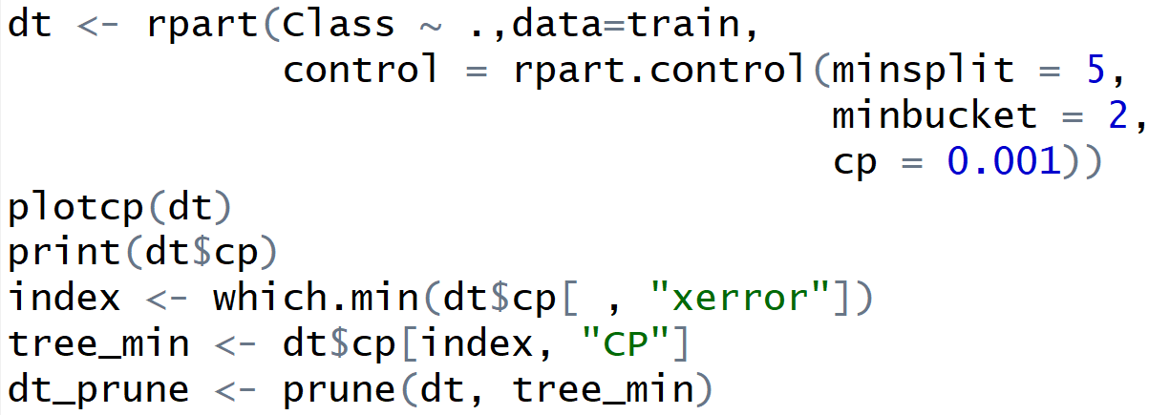
Fraud Detection with a Decision Tree
Decision Tree Built and Pruned
Pruned Decision Tree
Notes:
Yuwei - First, we use decision tree to do fraud detection.
We chose it because decision tree is ease to interpret and it requires few data preprocessing procesures such as variable selection and data scaling.
We first built a large single tree and prune the tree.
The result shows that V17, V14 and V12 are most important variables while time and amount are much less important in determining the fraud, which is in accordance with our exploratory data analysis

Slide 15
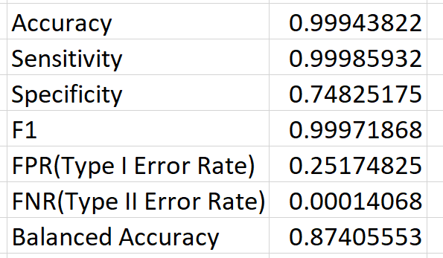
Fraud Detection with a Decision Tree
 |  | Predicted
 |  | Non-Fraud (0) | Fraud (1)
Actual | Non-Fraud (0) 85,300 | True Positive 85,288 | False Negative 12
 | Fraud (1) 143 | False Positive 36 | True Negative 107
Notes:
Yuwei - The result shows that accuracy is close to 1. Type II error is close to zero
But type I error is 0.25. It is seemingly good, right?
But is this really good?

Slide 16
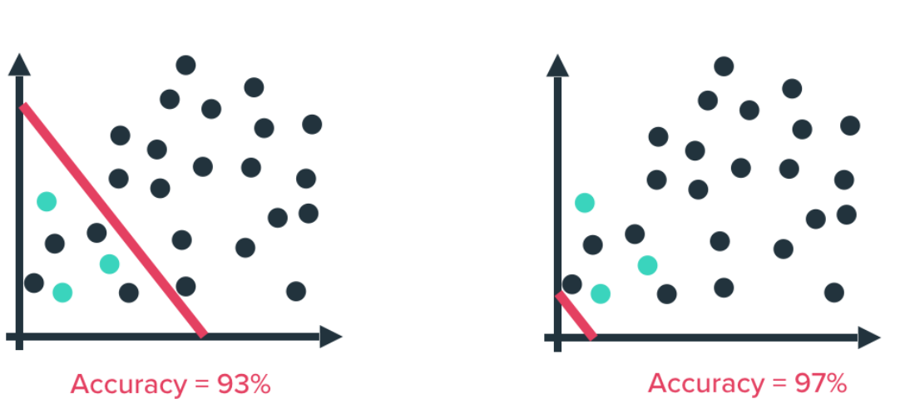
Accuracy isn’t Everything
Notes:
Because our dataset is so “diamond in the rough focused”, we run into the issue of accuracy not being our most important metric. If we classify everything as “non-fraudulent activity”, because there are so relatively few cases of fraud present, we’ll end up with a high accuracy anyway, which is obviously a bad situation.

Slide 17
Accuracy and its relationship to Type Errors
 |  | Predicted
 |  | Non-Fraud (0) | Fraud (1)
Actual | Non-Fraud (0) 284,315 | True Positive | False Negative Type II Error
 | Fraud (1) 492 | False Positive Type I Error | True Negative
Positive: Non Fraud
Negative: Fraud
Notes:
Tanner
In our case, we would rather have a situation that avoids false negatives where fraud occurs and we fail to predict it than one that favors accuracy in general.

Slide 18
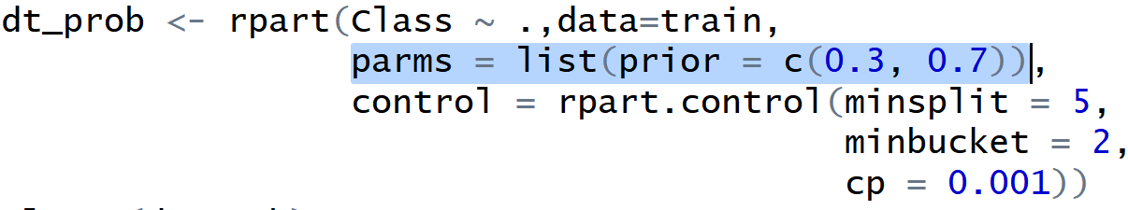
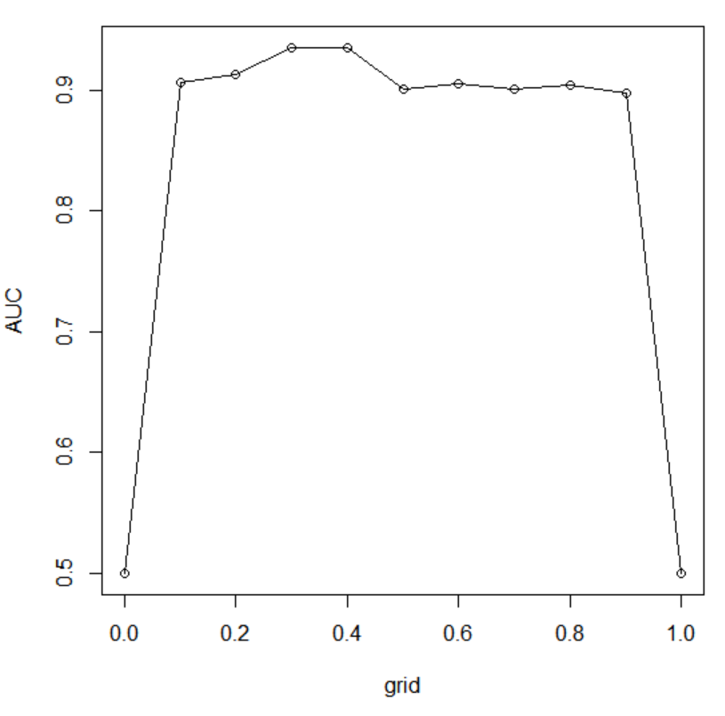
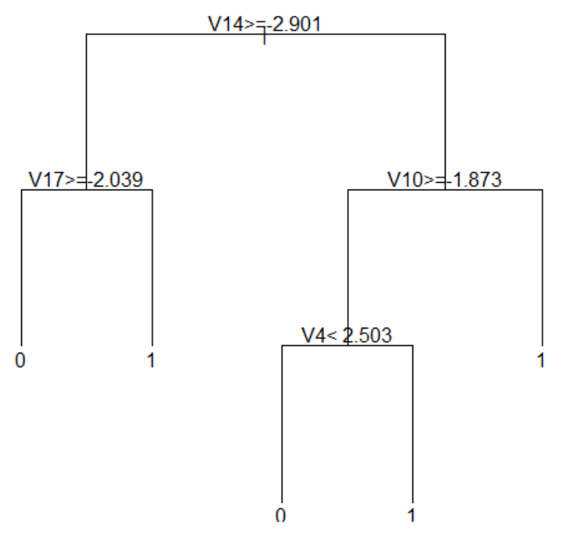
In response, we can change prior probabilities
Grid Search to find best priors combination
Pruned Decision Tree
Notes:
Yuwei - In response, we can change prior probabilities to deal with imbalanced data.
We first use grid search to find the pairs of priors that maximize AUC.

Slide 19
We can also apply a loss matrix
 |  | Predicted
 |  | Non-Fraud (0) | Fraud (1)
Actual | Non-Fraud (0) 85,300 | True Positive | Predict fraud, Actually not fraud
 | Fraud (1) 143 | Predict not fraud, actual fraud | True Negative
 |  | Predicted
 |  | Non-Fraud (0) | Fraud (1)
Actual | Non-Fraud (0) 85,300 | 0 | 1
 | Fraud (1) 143 | 100 | 0
Specifies penalties for different types of errors
Assumption: Type I Error penalized 100 times more than Type II Error
Notes:
In addition to changing priors directly, we can also apply a loss matrix to deal with imbalanced dataset.
Loss matrix could specify penalties for different types of errors;
In our example, we want to minimize type I error and thus we assume that Type I Error penalized 100 times more than Type II Error

Slide 20
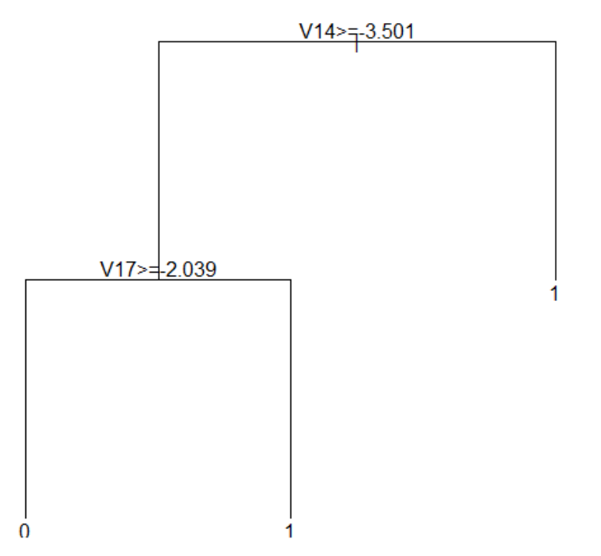
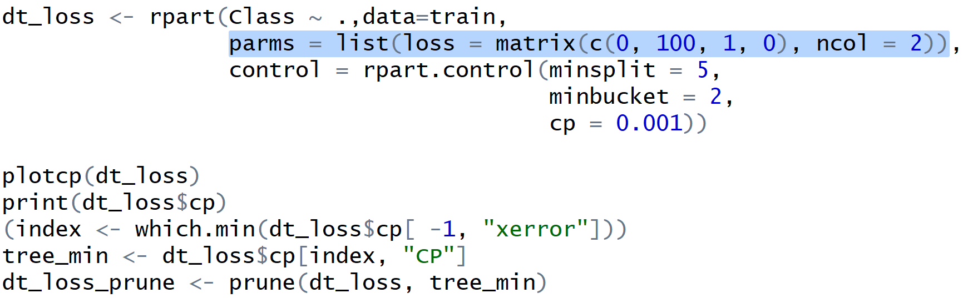
The loss matrix helps us deal with the imbalanced dataset
Decision Tree Built and Pruned
Pruned Decision Tree
Notes:
Here is the code for loss matrix and the result of pruned decision tree after applying loss matrix

Slide 21
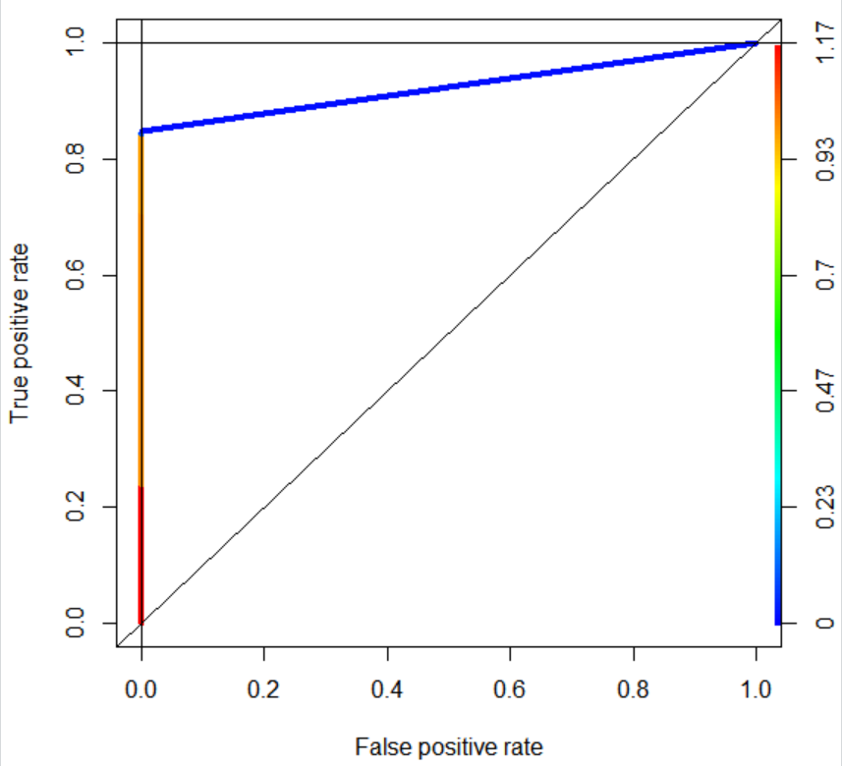
Apply a loss matrix to tune threshold
 |  | Predicted
 |  | Non-Fraud (0) | Fraud (1)
Actual | Non-Fraud (0) 85,300 | 0 1-β | 1 β
 | Fraud (1) 143 | 100 α | 0 1-α
1-β
α
Cost Function: 100α + β = 100 α - (1-β) + 1
Notes:
In addition to applying loss matrix to add penalties and thus adjust priors, we can also apply loss matrix to find the best threshold.
As you see in the left table, we assign 100 units cost to type I error and 1 unit cost to type II error.
Then we can write a cost function including type I error and type II error, or say alpha and beta.
Next, we need to find a combination of alpha and beta on ROC curve which can minimize the cost.

Slide 22
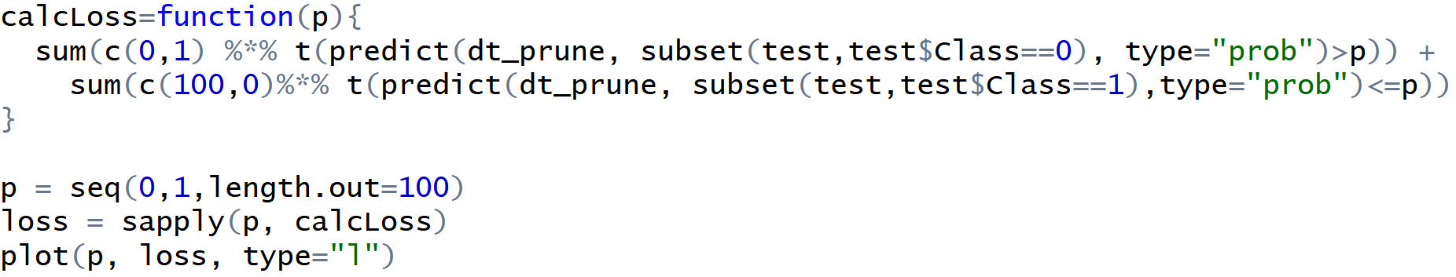
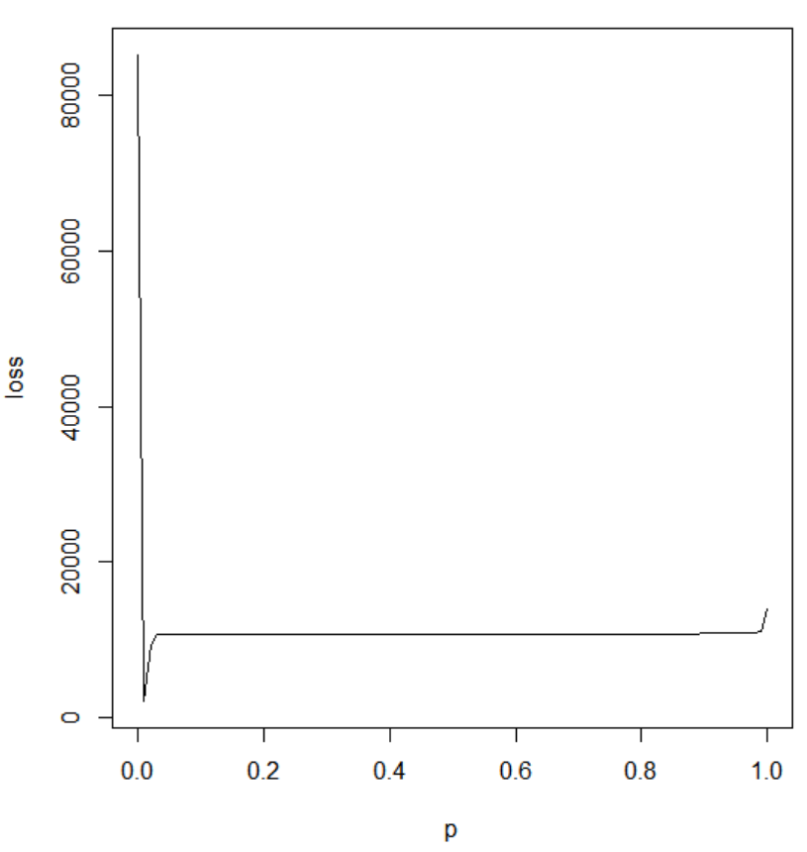
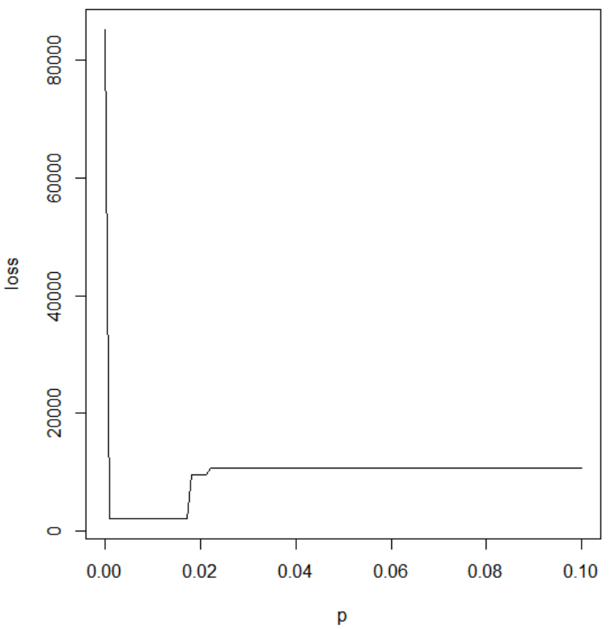
Apply a loss matrix to tune threshold
Zoom
Notes:
We set cutoff from 0 to 1 with 0.01 as steps.
And there plot total cost or say lost based on each threshold.
The result shows that our cost is minimized at somewhere closed to 0.
We zoomed in the graph there and we can see we can minimized our cost at around 0.01.

Slide 23
Model Comparison
Decision Tree with Changing Prior Probability
Decision Tree with
Loss Matrix
Decision Tree with
Best Cutoff
Decision Tree
True Positive 85,288 | False Negative 12
False Positive 36 | True Negative 107
True Positive 85,223 | False Negative 77
False Positive 32 | True Negative 111
Actual | Non Fraud 85,300
 | Fraud 143
True Positive 79,772 | False Negative 5528
False Positive 16 | True Negative 127
True Positive 85,004 | False Negative 296
False Positive 27 | True Negative 116
Accuracy
Sensitivity
Specificity
F1
FPR (Type I Error Rate)
FNR (Type II Error Rate)
Balanced Accuracy
AUC
0.999
1
0.748
1
0.252
0
0.874
0.878
0.935
0.935
0.888
0.966
0.111
0.065
0.911
0.935
0.996
0.997
0.811
0.998
0.189
0.003
0.904
0.904
0.999
0.999
0.776
0.999
0.224
0.001
0.888

Slide 24
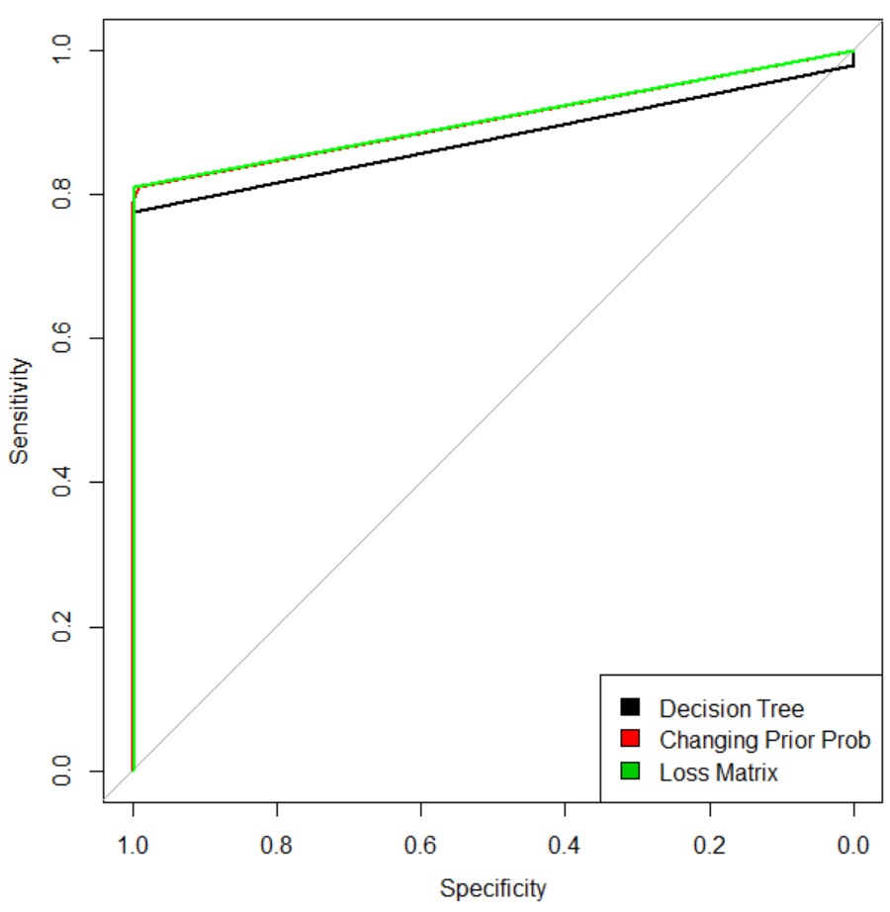
Model Comparison
Decision Tree
Changing Priors
Loss Matrix
Accuracy
Sensitivity
Specificity
F1
FPR (Type I Error Rate)
FNR (Type II Error Rate)
Balanced Accuracy
AUC
0.999
1
0.748
1
0.252
0
0.874
0.878
0.998
0.998
0.79
0.999
0.21
0.002
0.894
0.905
0.996
0.997
0.811
0.998
0.189
0.003
0.904
0.904

Slide 25
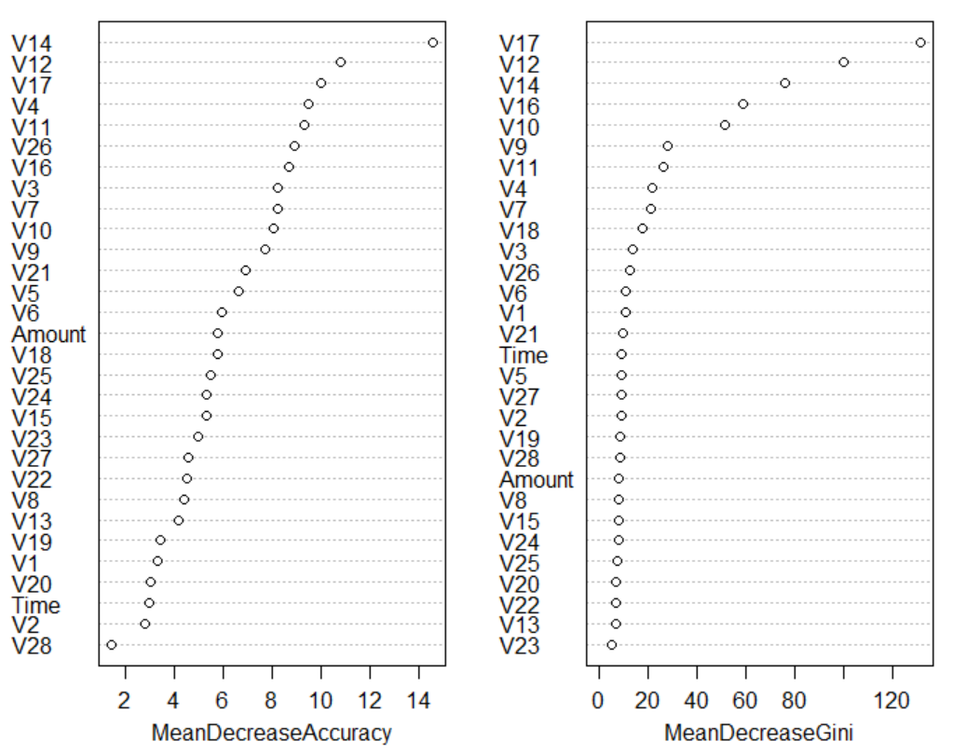
Fraud Detection with Random Forest
Decision Tree
Random Forest
 |  | Predicted
 |  | Non-Fraud (0) | Fraud (1)
Actual | Non-Fraud (0) 85,300 | True Positive 85,296 | False Negative 4
 | Fraud (1) 143 | False Positive 33 | True Negative 106
Accuracy
Sensitivity
Specificity
F1
FPR (Type I Error Rate)
FNR (Type II Error Rate)
Balanced Accuracy
AUC
0.999
1
0.748
1
0.252
0
0.874
0.878
1
1
0.763
1
0.237
0
0.881
0.928
Notes:
mtry : number of variables randomly sampled as candidates at each split

Slide 26
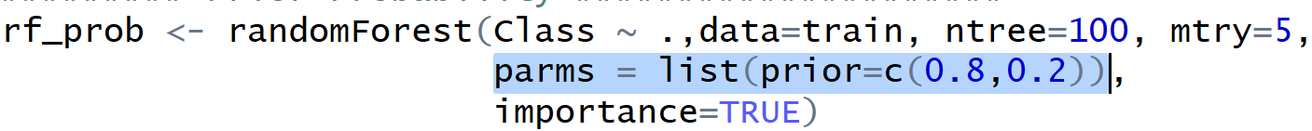
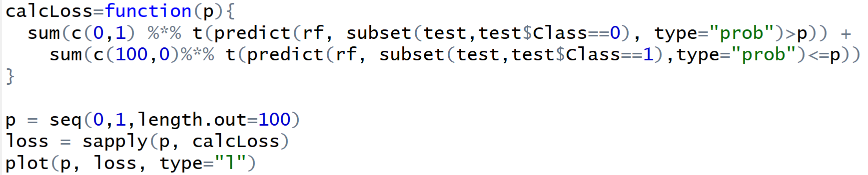
Manipulating Imbalanced Data in Random Forest
Changing priors
Applying loss matrix to tree split
Applying loss matrix to tune threshold
Changing class size representation in stratified random sample
Notes:
Specify values for class size representation in stratified random sample of 200 observations

Slide 27
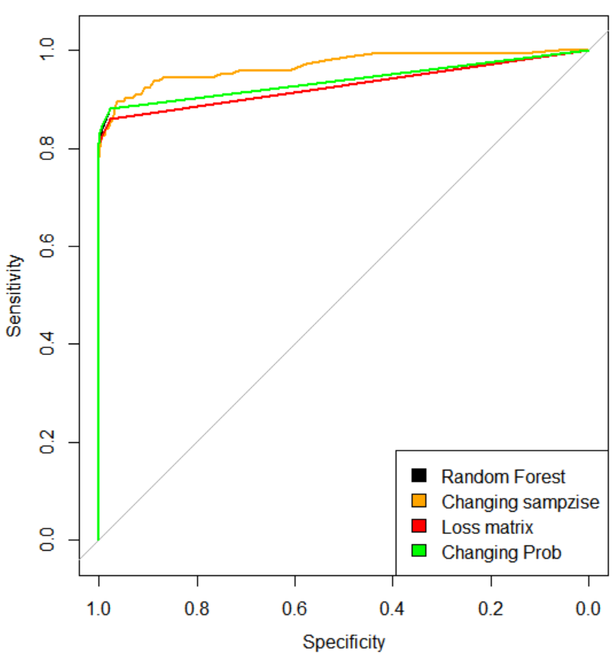
Model Comparison
Changing
Priors
Radom
Forest
Changing Sample Size
Changing
Cutoff
Loss
Matrix
Accuracy
Sensitivity
Specificity
F1
FPR (Type I Error Rate)
FNR (Type II Error Rate)
Balanced Accuracy
AUC
1
1
0.748
1
0.252
0
0.874
0.928
0.983
0.983
0.839
0.991
0.161
0.017
0.911
0.9678
0.977
0.977
0.881
0.988
0.119
0.023
0.929
1
1
0.762
1
0.238
0
0.881
0.928
1
1
0.763
1
0.237
0
0.881
0.928
Notes:
From the roc curve, we can see that changing parameters didn’t improve model that much..

Slide 28
Resampling
Notes:
Resampling method would also help us to better train our models to recognise fraud cases when there are very few cases of fraud.

Slide 29
Resampling
Undersampling
Oversampling and Undersampling
SMOTE
Notes:
In our project, we used three methods of resampling: undersampling, oversampling, and SMOTE

Slide 30
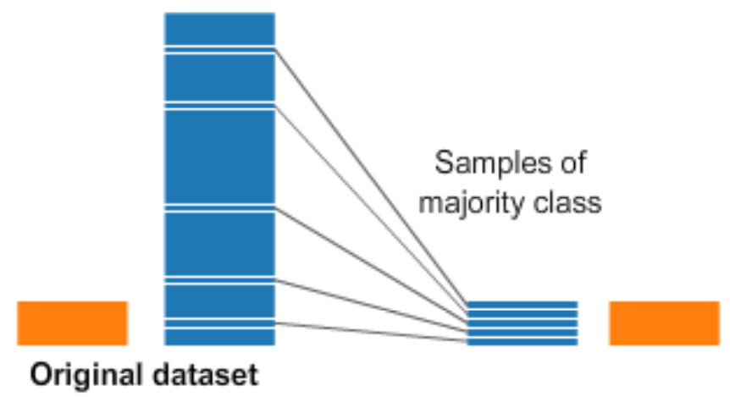
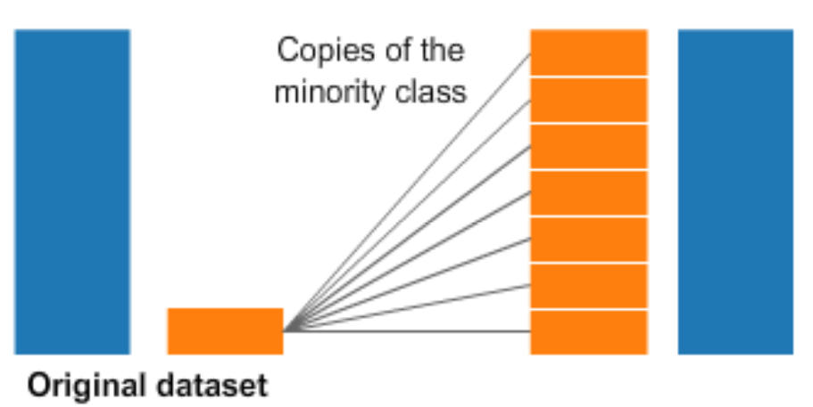
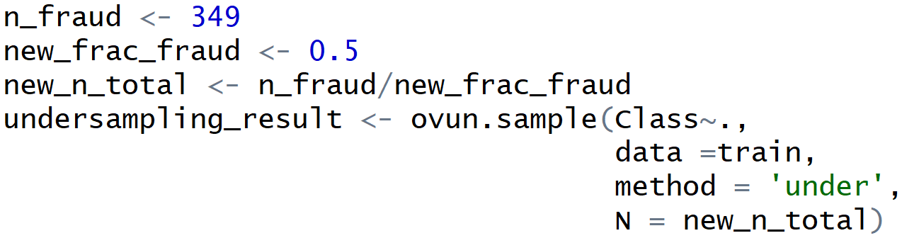
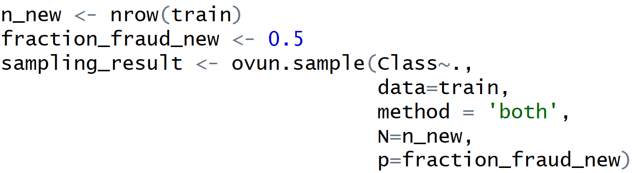
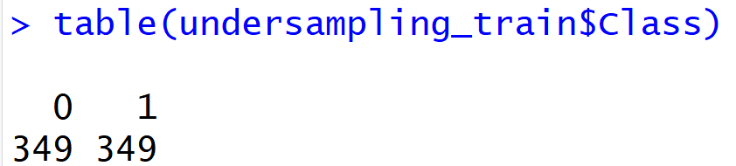
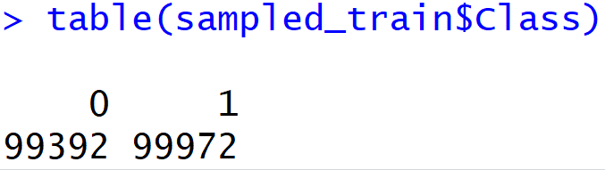
Undersampling and Oversampling
Undersampling Oversampling
Notes:
The most straightforward way to adjust the imbalance of the data is to undersample the majority class (aka non-fraud cases), or oversample the minority class (fraud cases).
With under-sampling, we take random draws from non-fraud observations, to match the amount of fraud observations
With over-sampling, we take random draws from the fraud cases, and copy those observations to increase the amount of fraud samples we have in our data.

Slide 31
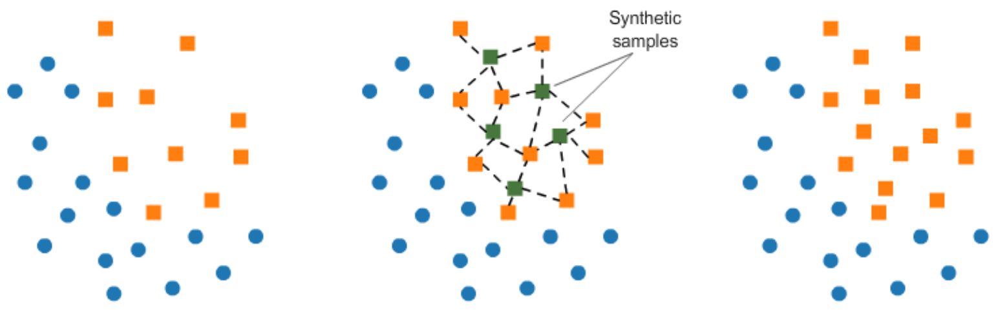
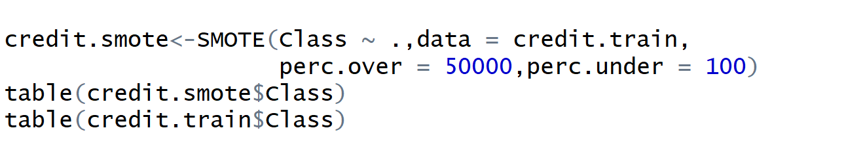
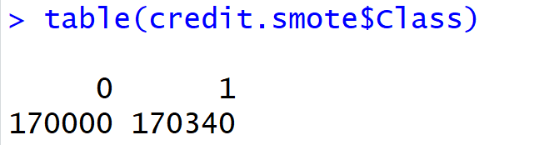
SMOTE (Synthetic Minority Oversampling Technique)
Notes:
We can also use a technique called SMOTE which will create additional synthetic fraud examples based on the characteristics of nearest neighbors. Unlike undersampling, this avoids duplicating observations.

Slide 32
Model Comparison with Random Forest
Changing
Priors
Radom
Forest
Changing Sample Size
Changing
Cutoff
Loss
Matrix
Accuracy
Sensitivity
Specificity
F1
FPR (Type I Error Rate)
FNR (Type II Error Rate)
Balanced Accuracy
AUC
1
1
0.748
1
0.252
0
0.874
0.928
0.983
0.983
0.839
0.991
0.161
0.017
0.911
0.9678
0.977
0.977
0.881
0.988
0.119
0.023
0.929
1
1
0.762
1
0.238
0
0.881
0.928
1
1
0.763
1
0.237
0
0.881
0.928
Notes:
From the roc curve, we can see that changing parameters didn’t improve model that much..

Slide 33
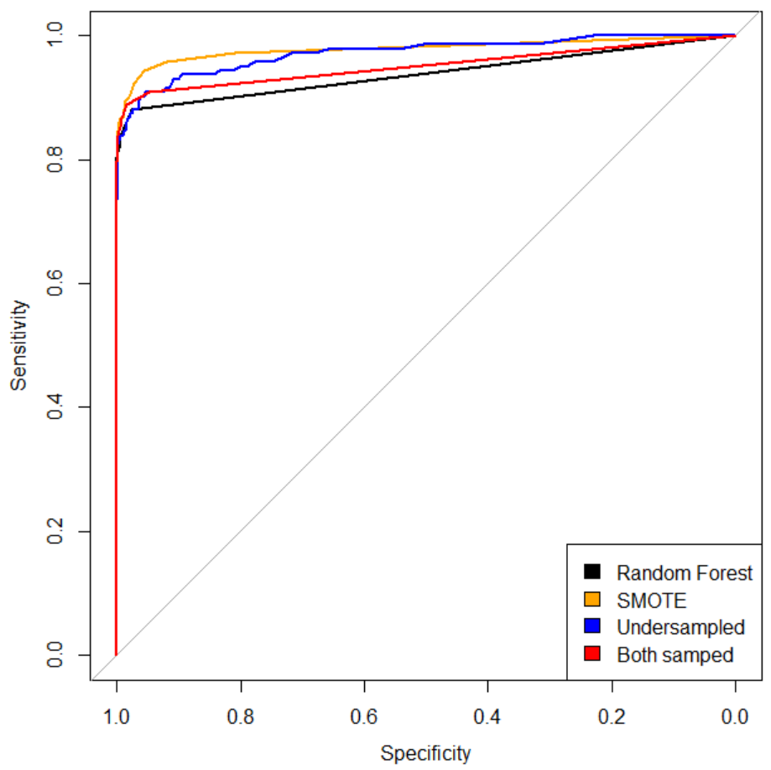
Model Comparison with Random Forest
Radom
Forest
Changing Sample Size
Under
Sampled
Both
Sampled
SMOTE
Accuracy
Sensitivity
Specificity
F1
FPR (Type I Error Rate)
FNR (Type II Error Rate)
Balanced Accuracy
AUC
1
1
0.748
1
0.252
0
0.874
0.928
0.983
0.983
0.839
0.991
0.161
0.017
0.911
0.9678
0.976
0.976
0.874
0.988
0.126
0.024
0.925
0.972
1
1
0.79
1
0.21
0
0.895
0.951
0.999
1
0.811
1
0.189
0
0.905
0.979

Slide 34
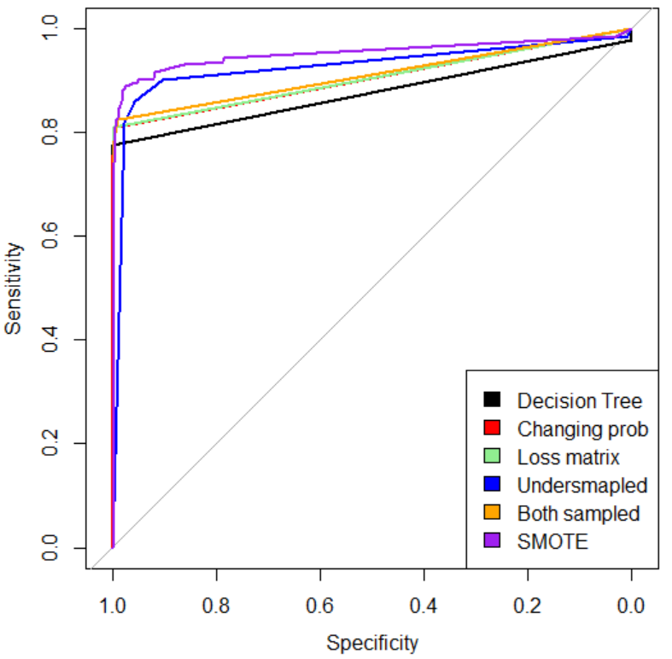
Model Comparison with Decision Tree
Changing
Priors
Decision
Tree
SMOTE
Loss
Matrix
Under
Sampled
Both Sampled
Accuracy
Sensitivity
Specificity
F1
FPR (Type I Error Rate)
FNR (Type II Error Rate)
Balanced Accuracy
AUC
0.999
1
0.748
1
0.252
0
0.874
0.878
0.957
0.958
0.86
0.978
0.14
0.042
0.909
0.927
0.988
0.988
0.825
0.994
0.175
0.012
0.907
0.911
0.976
0.976
0.888
0.988
0.112
0.024
0.932
0.954
0.998
0.998
0.79
0.999
0.21
0.002
0.894
0.905
0.996
0.997
0.811
0.998
0.189
0.003
0.904
0.904

Slide 35
Supervised Learning isn’t Enough
Might not always have a large dataset
Fraud changes, may not have the same desired outcomes
We can instead utilize unsupervised learning to search for outliers.
Notes:
Tanner

Slide 36
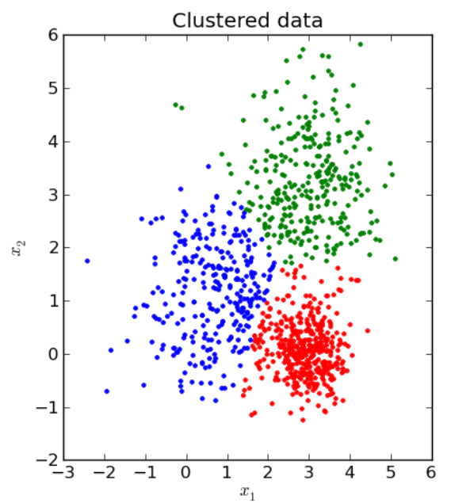
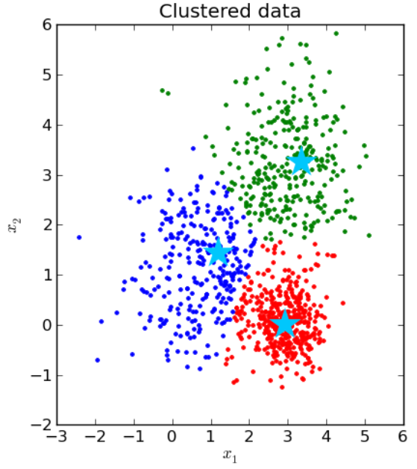
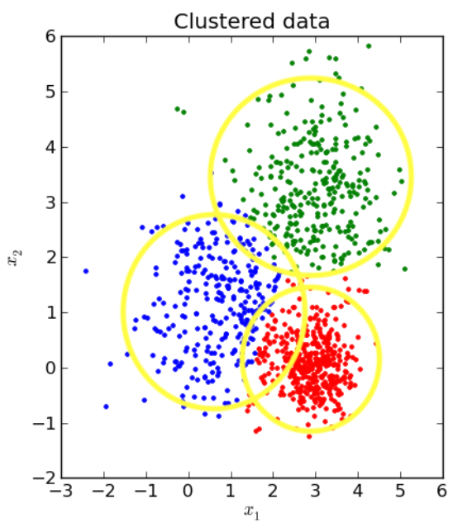
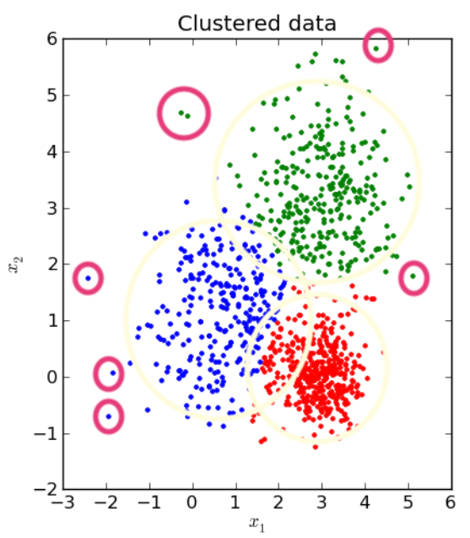
K-Means Clustering
Starting with clustered data
Assign the cluster centroids
Define distances from the cluster centroid
Flag fraud for those furthest away from cluster centroid
Notes:
So, we applied k-means to detect suspicious activities.
In a nutshell, we take the outliers of each cluster and flag those as fraud.
For example, we are looking at three clusters.
In the first step, we need to collect and store the cluster centroids, as that is the starting point to decide what’s normal and what’s not.
The next step is to calculate the distance of each point in the dataset, to their own cluster centroid.
In this case, we use euclidian distance, hence we see these depicted as round circles.
Then, we need to define a cut-off point for the distances to define what is an outlier.
We can do this based on the distribution of the distance collected like taking the tail of the distribution of distances

Slide 37
K-Means Clustering
V14 and V17 are two most important variables
Notes:
Decision tree

Slide 38
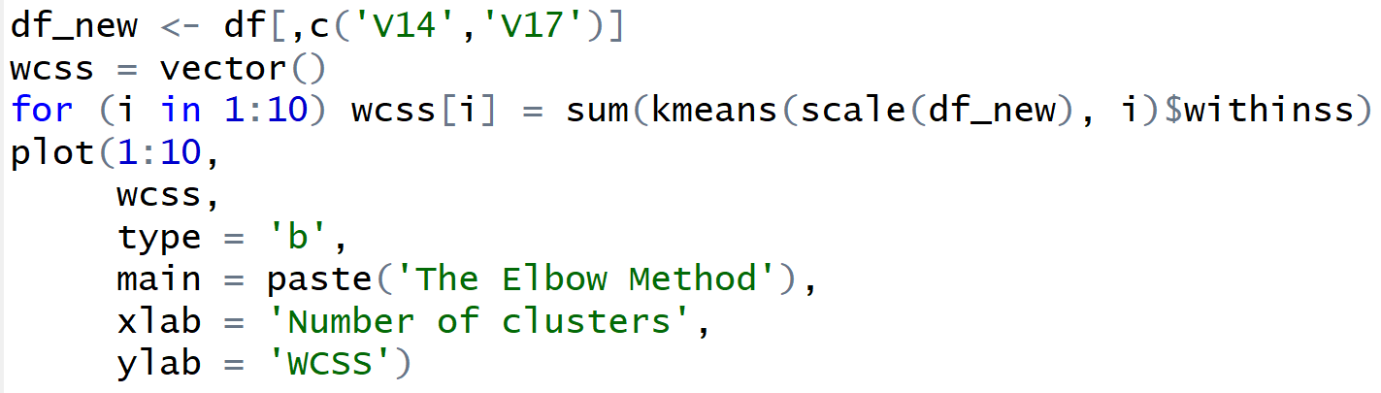
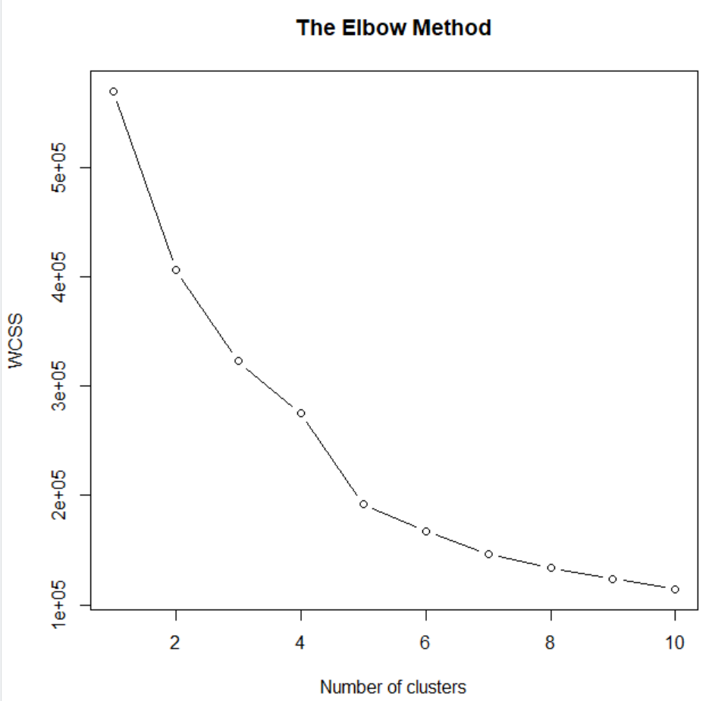
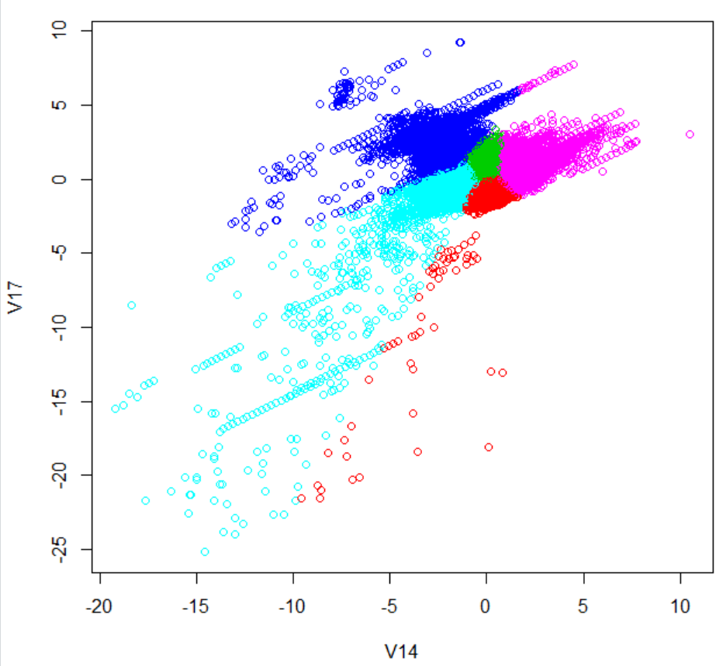
K-Means Clustering
Applying K-Means Clustering
Notes:
How many clusters we need?
We use elbow method to choose, and ended up with 5

Slide 39
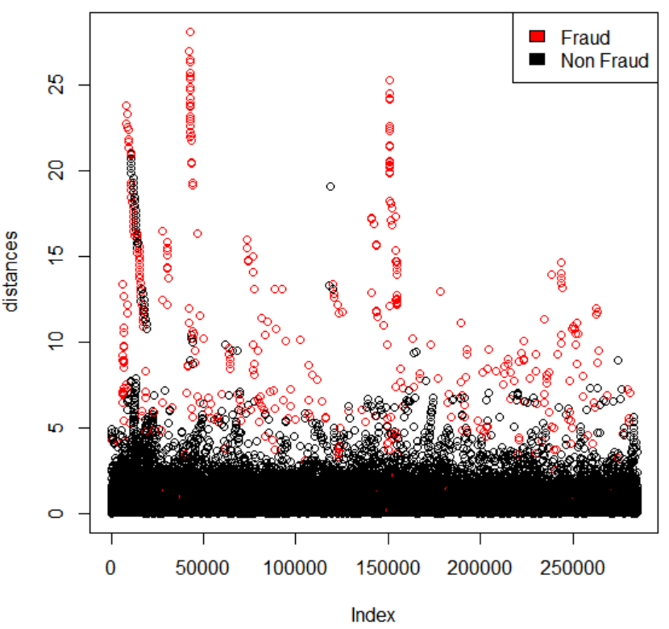
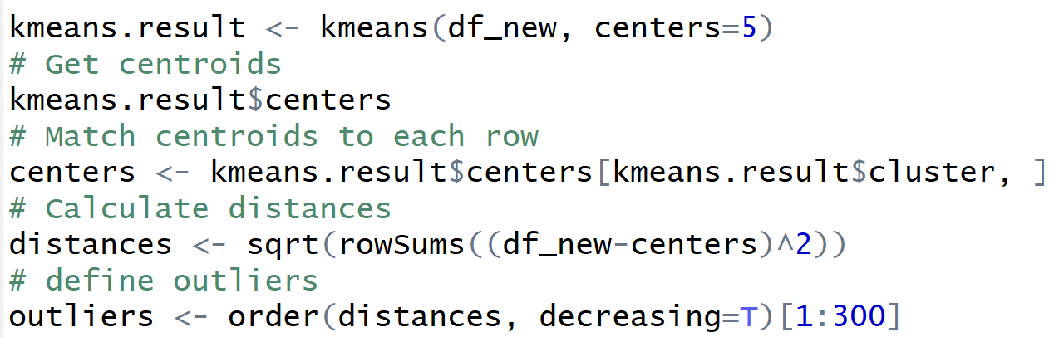

K-Means Clustering
Notes:
Ultimately, we see a representation where the vast majority of fraud cases have a euclidean distance from the centroid much greater than the pack of the non-fraudulent cases, suggesting that analyzing outliers from k means gives us a good background to start.

Slide 40
Conclusion
Fraud is tricky--it evolves over time.
Fraud detection requires supervised and unsupervised learning
Be cautious with imbalanced data
Domain experts could provide further context
V14 and V17 appear to be our most important variables by a large margin
Should we have non-anonymized data, we would choose to focus on those.

Slide 41
Questions?

Slide 42


Supporting Files
Decision Tree
Random Forest

Slide 43
Priors
The prior probability of an event is the probability of the event computed before the collection of new data. One begins with a prior probability of an event and revises it in the light of new data. For example, if 0.01 of a population has schizophrenia then the probability that a person drawn at random would have schizophrenia is 0.01. This is the prior probability. If you then learn that that there score on a personality test suggests the person is schizophrenic, you would adjust your probability accordingly. The adjusted probability is the posterior probability.

Slide 44


Apply a loss matrix to tune threshold
Notes:
More variance

